Slide 1


Slide 2
Using State-of-the-Art Machine Learning Models for Binary Classification of Road Rutting Severity with Unbalanced Datasets
Akhil Naseem (22237476)
Dr. Ghulam Mubashar Hassan, School of Physics, Maths and Computing, Computer Science and Software Engineering
Dr. Du Huynh, School of Physics, Maths and Computing, Computer Science and Software Engineering
Dr. Mark Reynolds, Head of School, School of Physics, Mathematics and Computing
Notes:
Add slide numbers
Separate slide for data imbalance
Main roads suggest 15 is bad
Confusion matrix
ROC curve
Literature review

Slide 3
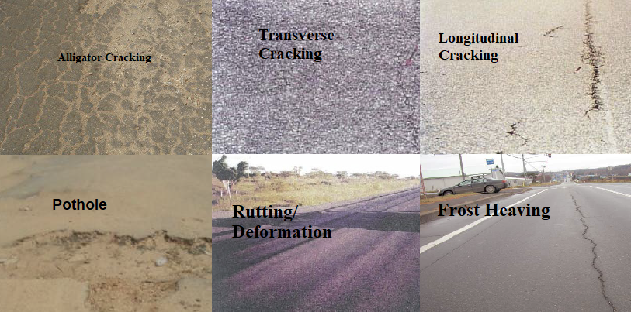
Road defects

Slide 4
Road defects

Slide 5
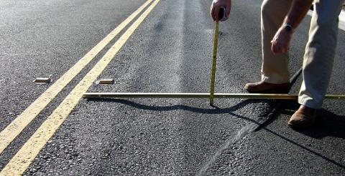
What is rutting?
Excessive channelised deformation in the wheel paths of the road.
Quality Engineering Solutions, Inc

Slide 6
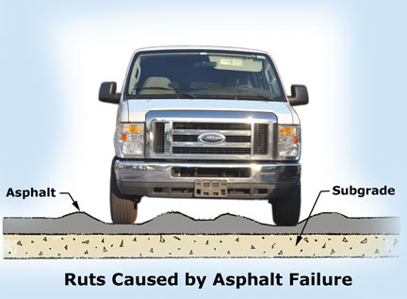
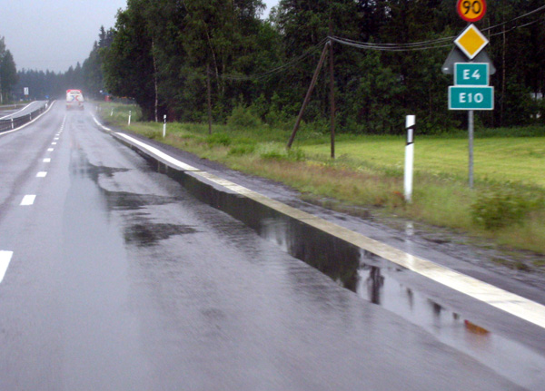
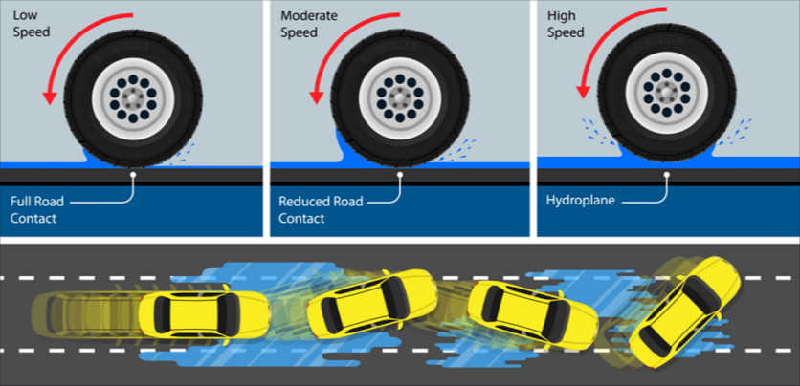
Why is it a problem?
Grooves pull tyres towards rut
Water ponding
Hydroplaning
Atlanta Engineering Services, Inc
Roadex.org
Cardinus.org

Slide 7
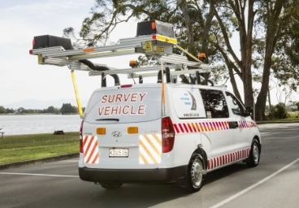
How is it monitored?
Manual onsite inspections
Automated surveying
Quality Engineering Solutions, Inc
romdas.com

Slide 8
How is it monitored?
Manual onsite inspections
Automated surveying
Impractical for long stretches
Quality Engineering Solutions, Inc
romdas.com

Slide 9
How is it monitored?
Manual onsite inspections
Automated surveying
Impractical for long stretches
Expensive
Quality Engineering Solutions, Inc
romdas.com

Slide 10
Now that we know what rutting is…
What are we trying to solve?

Slide 11
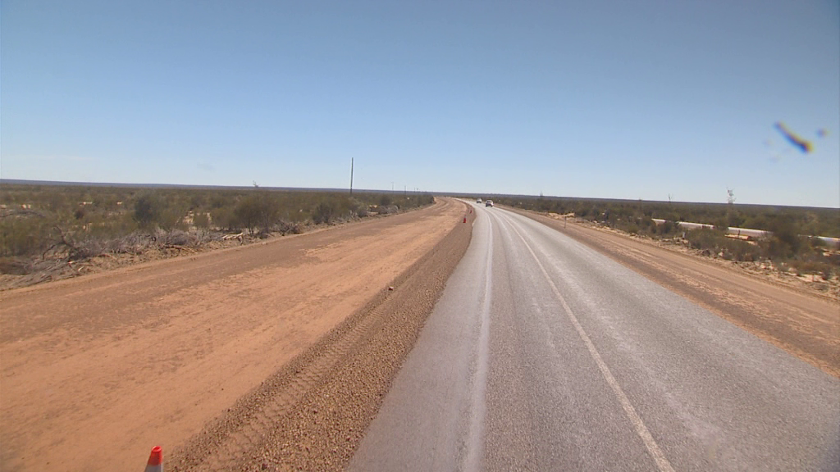
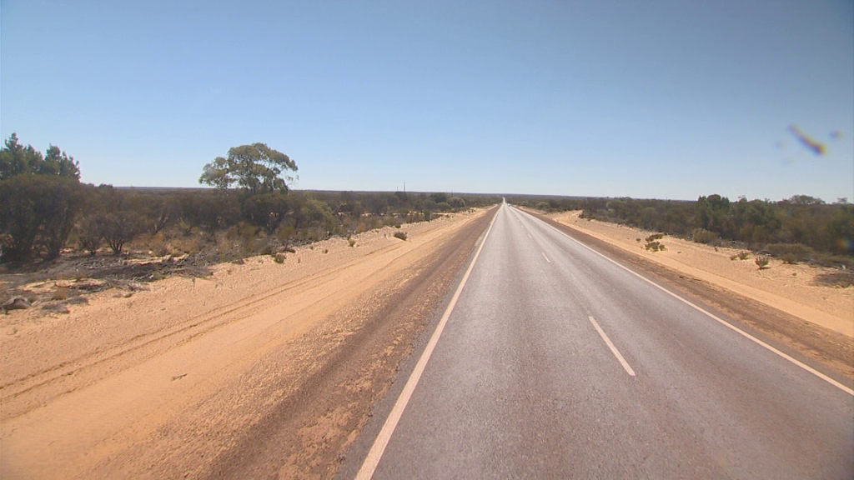
Problem scope
Client: Main Roads WA
Domain: detecting road rutting severity
Problem: road inspections are expensive or impractical for long stretches
Research: use computer vision and machine learning techniques to identify regions with severe rutting
48.1mm
3.1mm
Notes:
Cheap images (not high precision)
off-the shelf dashcam

Slide 12
Brief Literature Review
Maeda H, Sekimoto Y, Seto T, Kashiyama T, Omata H. Road Damage Detection and Classification Using Deep Neural Networks with Smartphone Images. Comput Civ Infrastruct Eng. 2018 Dec 1;33(12):1127–41.
Majidifard H, Adu-Gyamfi Y, Buttlar WG. Deep machine learning approach to develop a new asphalt pavement condition index. Constr Build Mater. 2020 Jun 30;247:118513.
Used Google Maps images
Detect damages like cracks and potholes
Tedeschi A, Benedetto F. A real-time automatic pavement crack and pothole recognition system for mobile Android-based devices. Adv Eng Informatics. 2017 Apr 1;32:11–25.
Rajab MI. Profiling of external deformation in asphalt pavement rutting using image analysis method. In: Proceedings - 2013 IEEE 9th International Colloquium on Signal Processing and its Applications, CSPA 2013. 2013. p. 99–102.
Identifies rutting, limited data sample

Slide 13
Available data
Dashcam videos
Sensor data

Slide 14
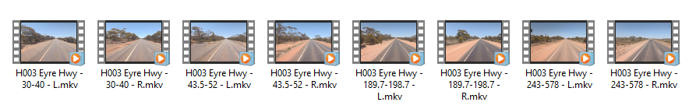
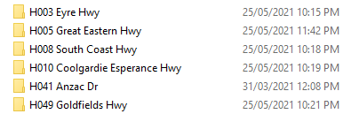
Available data - videos

Slide 15
Available data - videos

Slide 16
Available data - videos
Notes:
Add example of a frame

Slide 17
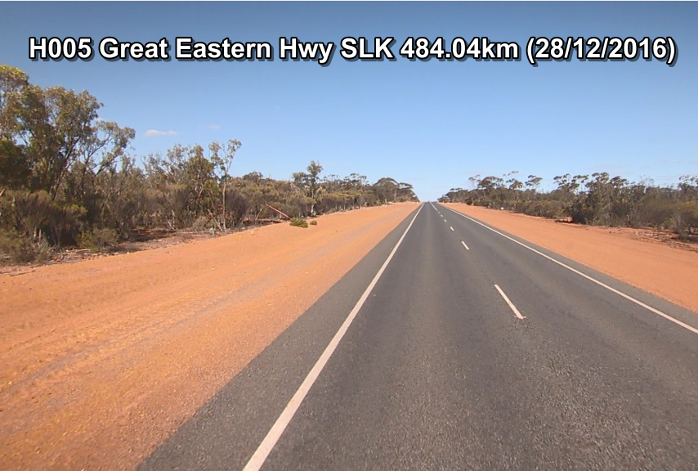
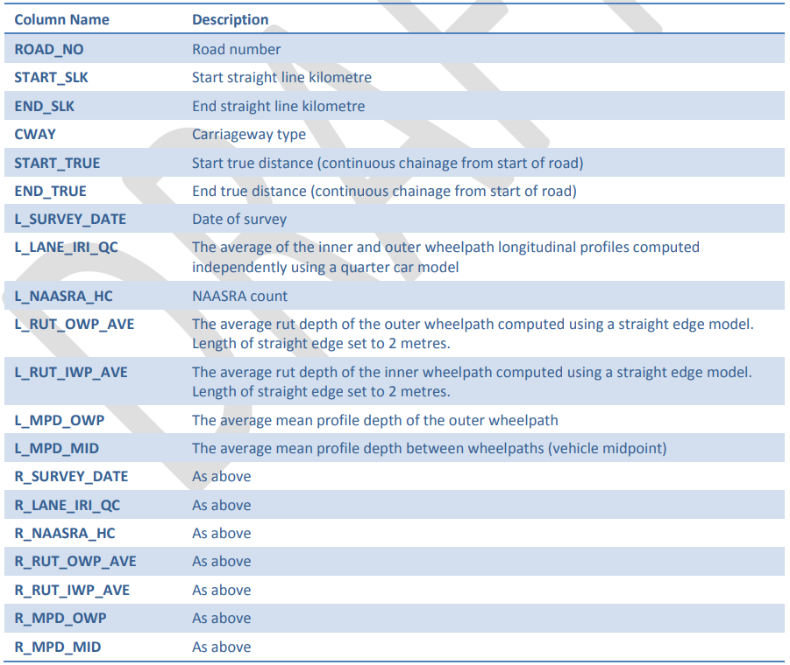
Available data - sensor values
data.csv
Location id
Left lane
Right lane
Notes:
Add image of OWP and IWP

Slide 18
Available data - sensor values
data.csv
(1)
(1) Location id
Left lane
Right lane
Notes:
Add image of OWP and IWP

Slide 19
Available data - sensor values
data.csv
(1)
(1) Location id
(2)
(3)
(2)
Left lane
(3)
Right lane
Notes:
Add image of OWP and IWP

Slide 20
Available data - sensor values
data.csv
(1)
(1) Location id
(2)
(3)
Rutting at left lane = max((2), (3))
(2)
Left lane
(3)
Right lane
Notes:
Add image of OWP and IWP

Slide 21
Available data - sensor values
data.csv
(1)
(1) Location id
(4)
(4)
Rutting at left lane = max((2), (3))
Left lane
Notes:
Add image of OWP and IWP

Slide 22
Available data - sensor values
data.csv
(1)
(1) Location id
(4)
(5)
(4)
Rutting at left lane = max((2), (3))
Left lane
(5)
Rutting at right lane = max(IWP, OWP)
Right lane
Notes:
Add image of OWP and IWP

Slide 23
Now that we know what we have…
What do we do with it?

Slide 24
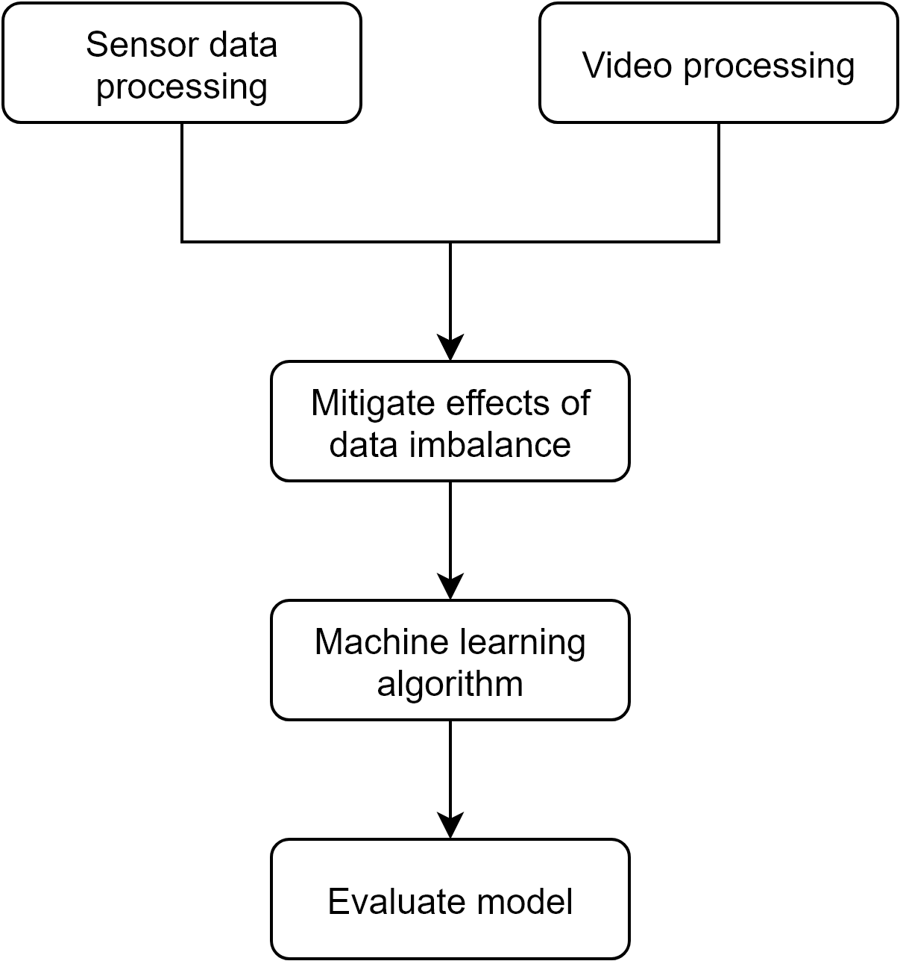
Methodology

Slide 25
Methodology

Slide 26
Methodology - sensor values preprocessing
data.csv
(1)
(1) Location id
(4)
(5)
(4)
Rutting at left lane = max((2), (3))
Left lane
(5)
Rutting at right lane = max(IWO, OWP)
Right lane
Notes:
Add image of OWP and IWP

Slide 27
Methodology
This was very tedious

Slide 28
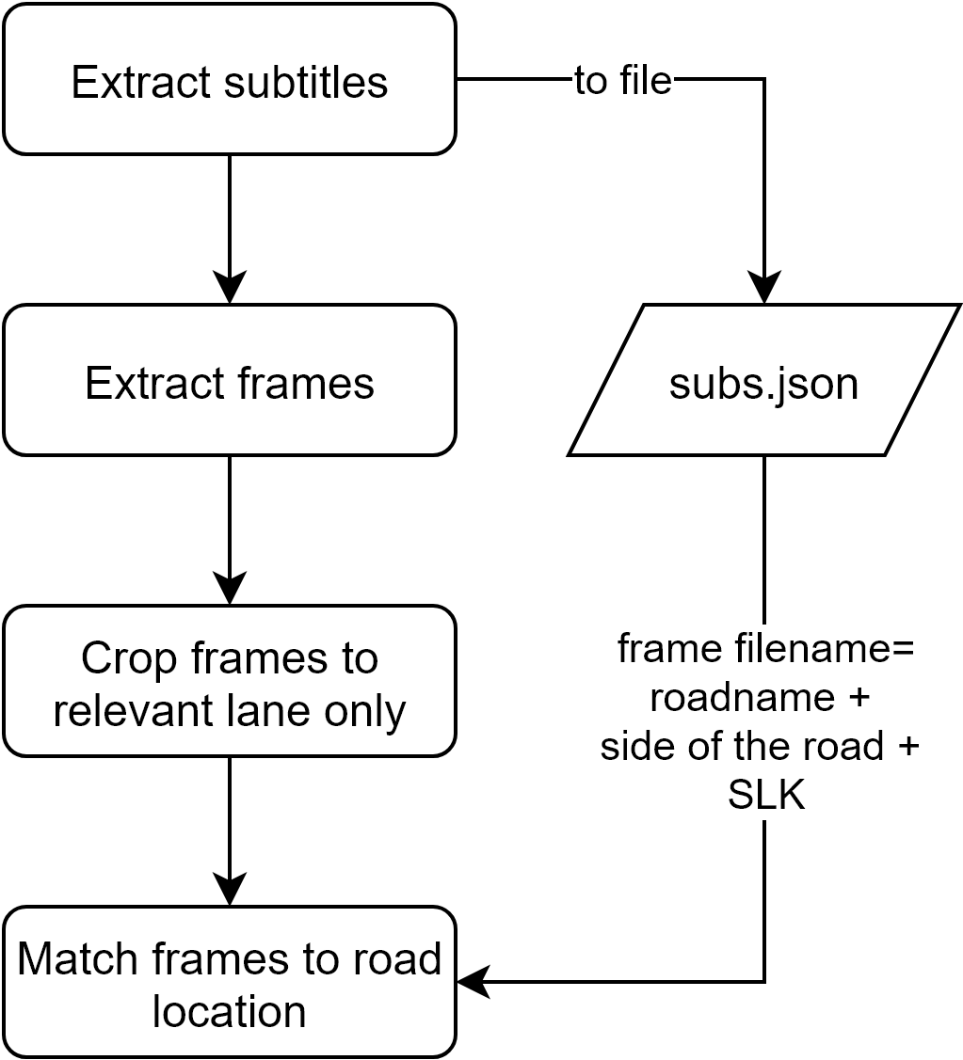
Methodology - Video preprocessing

Slide 29

Methodology - Video preprocessing

Slide 30
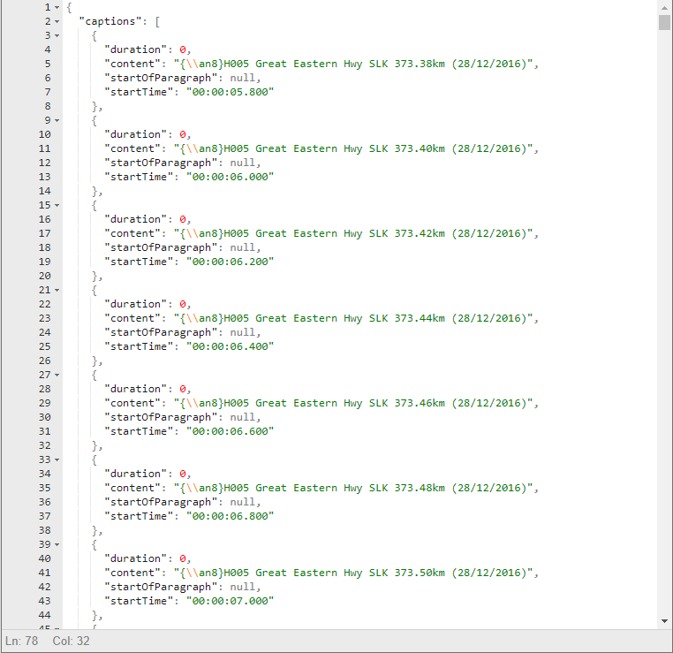
Methodology - Video preprocessing

Slide 31
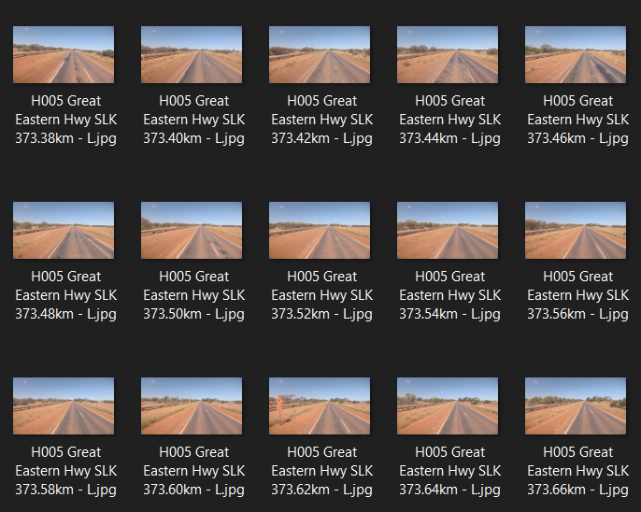
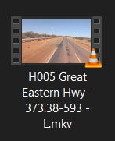
Methodology - Video preprocessing

Slide 32
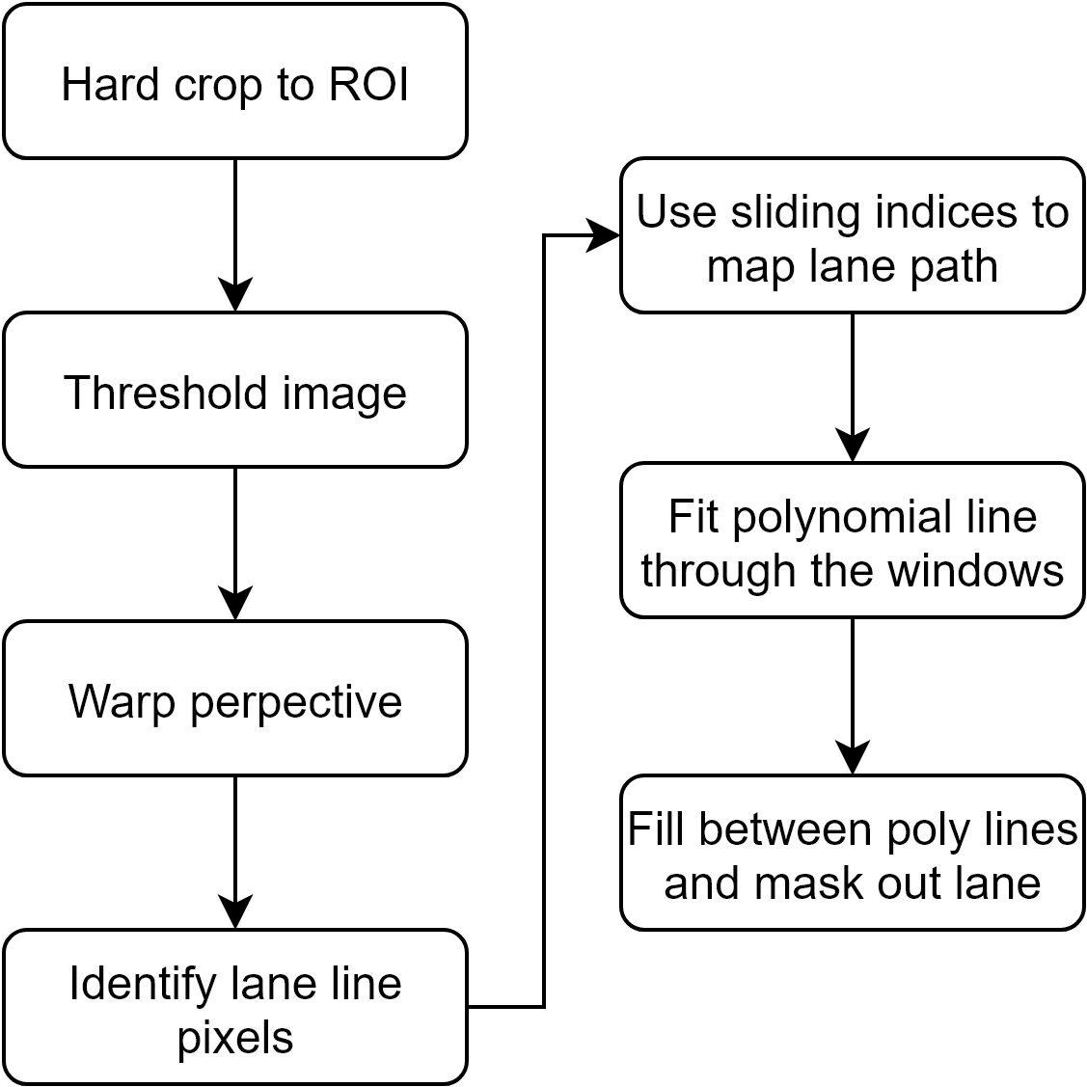
Methodology - Image preprocessing

Slide 33
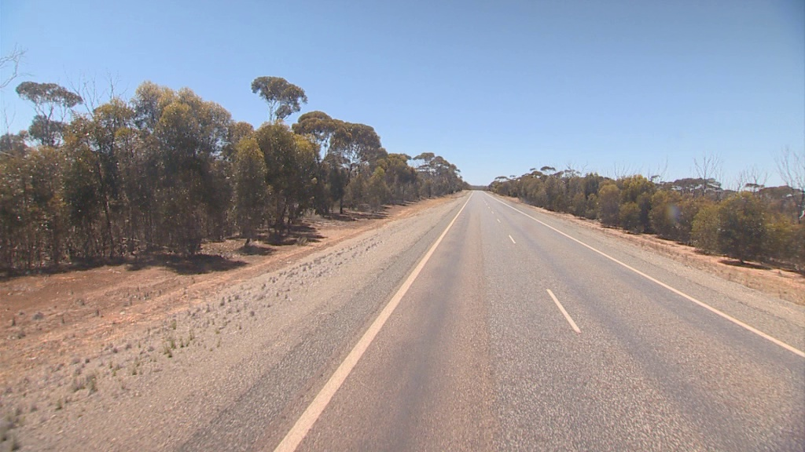
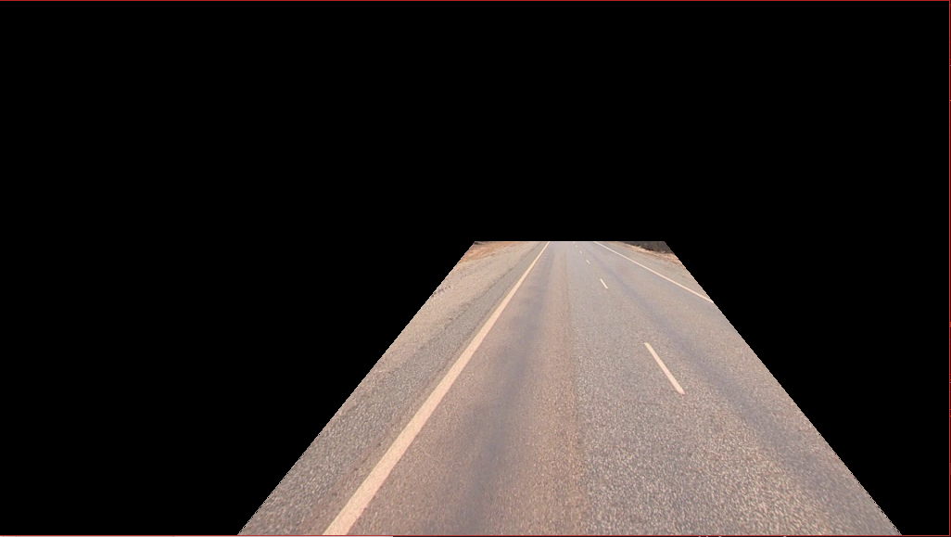
Methodology - Image preprocessing

Slide 34
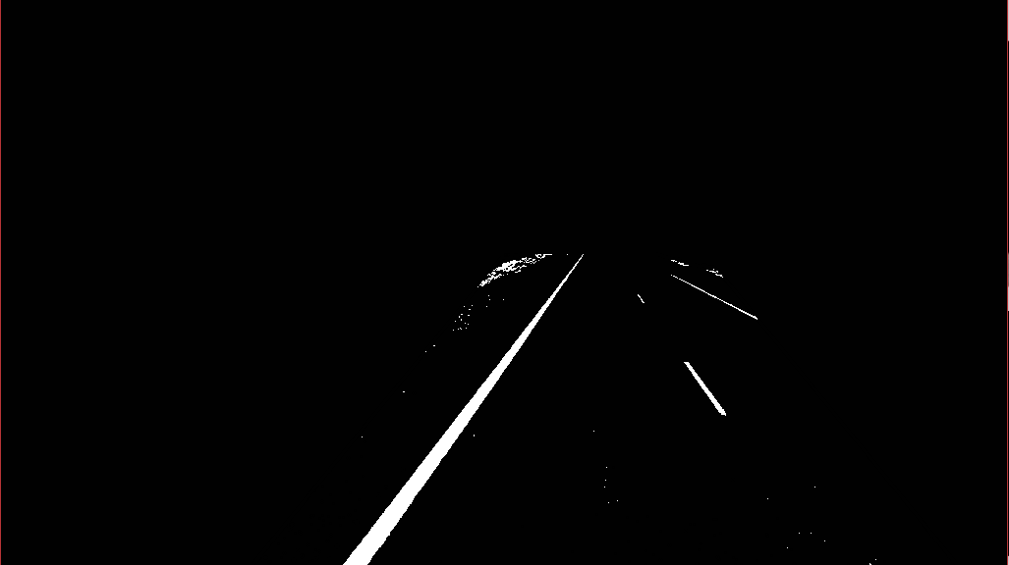
Methodology - Image preprocessing

Slide 35
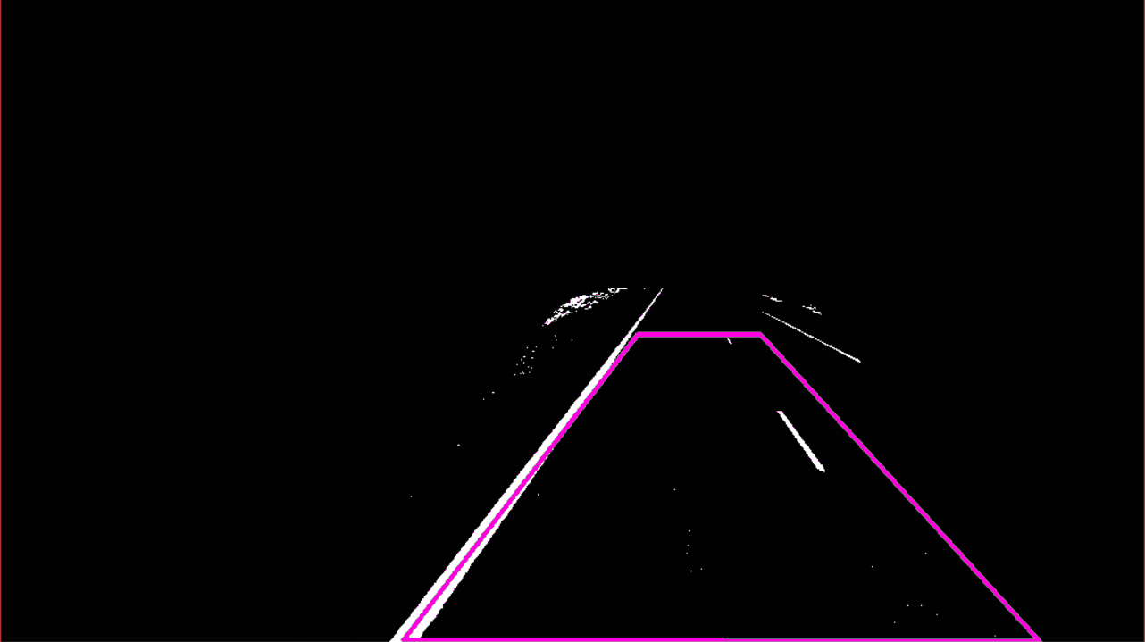
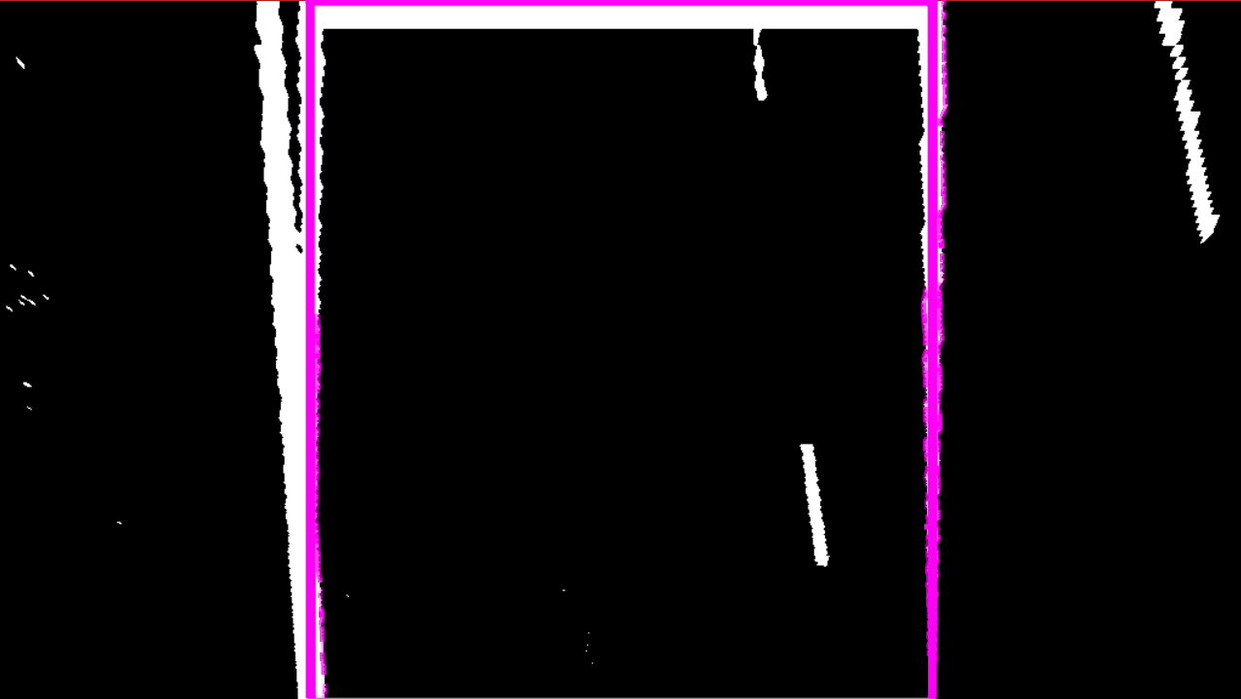
Methodology - Image preprocessing

Slide 36
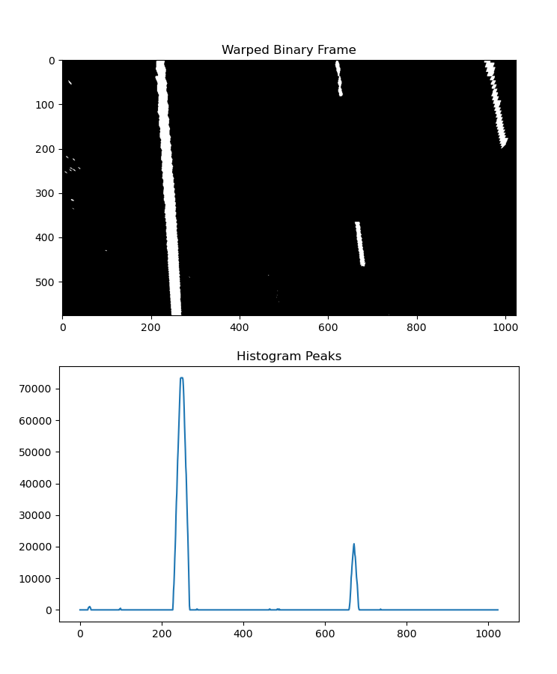
Methodology - Image preprocessing

Slide 37
Methodology - Image preprocessing

Slide 38
Methodology - Image preprocessing

Slide 39
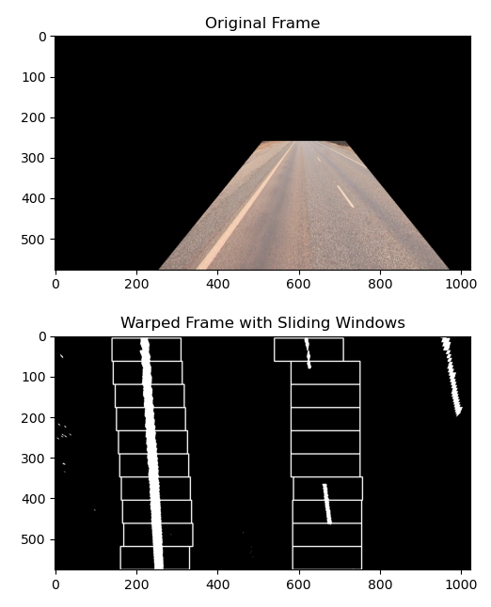
Methodology - Image preprocessing

Slide 40
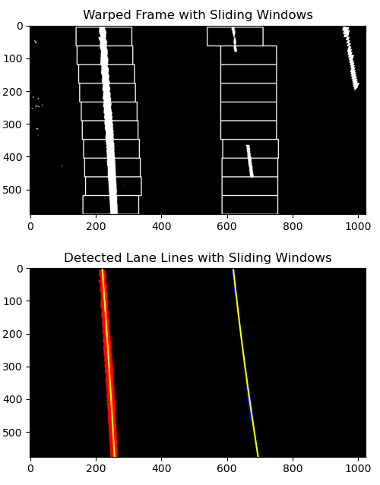
Methodology - Image preprocessing

Slide 41
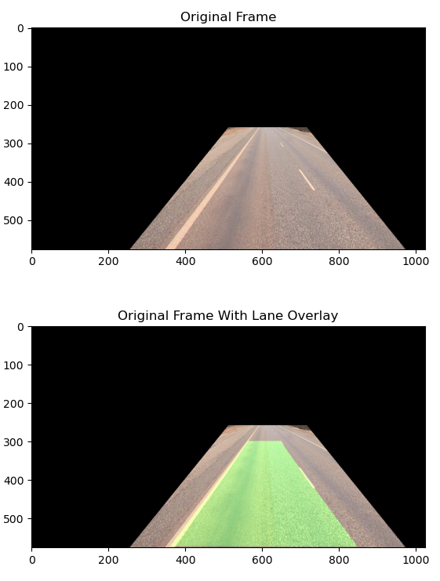
Methodology - Image preprocessing

Slide 42
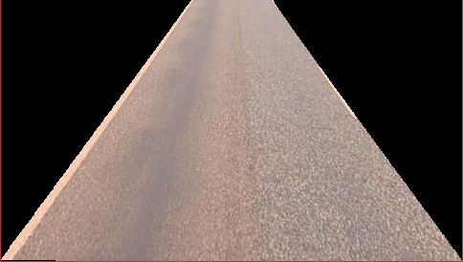
Methodology - Image preprocessing

Slide 43
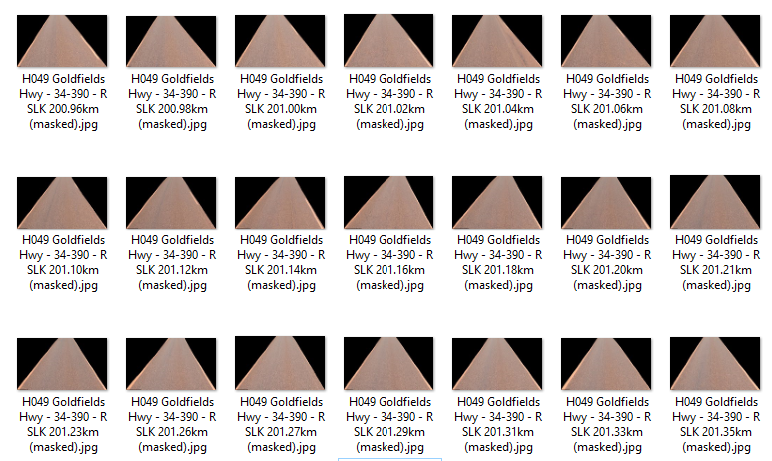
Methodology - Image preprocessing

Slide 44
Methodology
This was very tedious
phew!

Slide 45
Methodology

Slide 46
Methodology - Data imbalance
Problem
Lots of good roads
Very few bad roads (<0.5%)
Mitigation
Undersample good roads, oversample bad roads
Only consider extremes (i.e. very good and very bad)
Increase class weighting for bad roads
Binary classification only

Slide 47
Methodology - Machine learning algorithm
Simple Convolutional Neural Network
MobileNet
YOLOv5

Slide 48
Methodology - Machine learning algorithm
Accuracy
Recall
Precision
Confusion matrix

Slide 49
Results
 | Simple CNN | MobileNet | YOLOv5s
Params | 50,000 | 4.2M | 7.3M
Accuracy | 85% | 43% | 85%
Precision (for bad roads) | 67% | 17% | WIP
Recall (for bad roads) | 1% | 71% | WIP

Slide 50
Results
 | Simple CNN | MobileNet | YOLOv5s
Precision (for bad roads) | 67% | 17% | WIP
Recall (for bad roads) | 1% | 71% | WIP
Precision: helps make sure what is predicted as a bad road, actually is a bad road.
Recall: helps makes sure we are not missing out on any bad roads.

Slide 51
Results
 | Simple CNN | MobileNet | YOLOv5s
Precision (for bad roads) | 67% | 17% | WIP
Recall (for bad roads) | 1% | 71% | WIP
Precision: helps make sure what is predicted as a bad road, actually is a bad road.
Recall: helps makes sure we are not missing out on any bad roads.

Slide 52
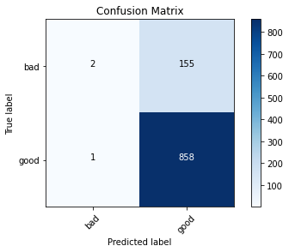
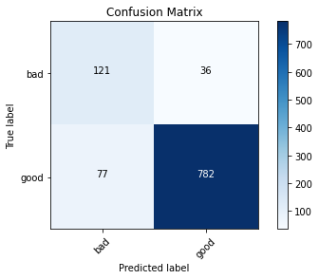
Results
SimpleCNN | MobileNet | YOLOv5
 |  | WIP

Slide 53
Results
SimpleCNN | MobileNet ✅ | YOLOv5
 |  | WIP

Slide 54
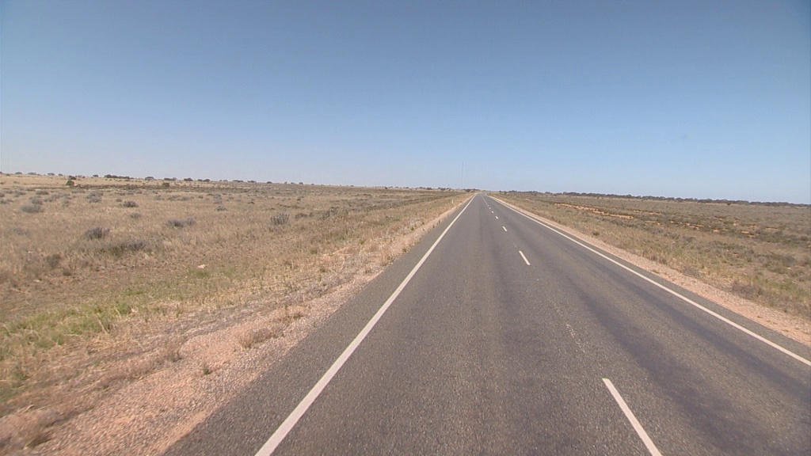
Limitations
Difficult to classify even with visual inspection of images
Lack of SME to help understand dataset
Very imbalanced dataset
Lane cropping not robust to edge cases (unclear lane markings, dusty roads, other straight line road defects)
Limited hardware
?

Slide 55
Limitations
Difficult to classify even with visual inspection of images
Lack of SME to help understand dataset
Very imbalanced dataset
Lane cropping not robust to edge cases (unclear lane markings, dusty roads, other straight line road defects)
Limited hardware
<0.5% bad roads

Slide 56
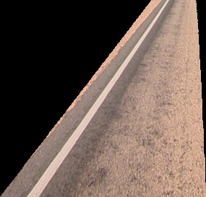
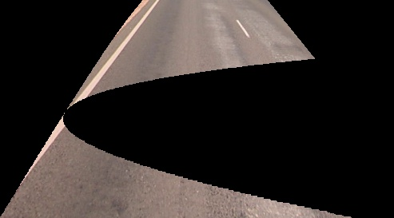
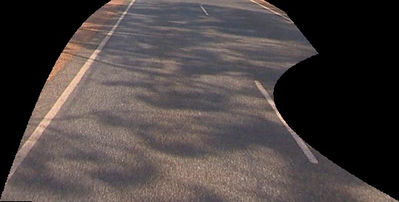
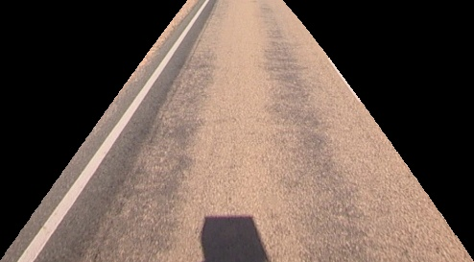
Limitations
Difficult to classify even with visual inspection of images
Lack of SME to help understand dataset
Very imbalanced dataset
Lane cropping not robust to edge cases (unclear lane markings, dusty roads, other straight line road defects)
Limited hardware

Slide 57
Limitations
Difficult to classify even with visual inspection of images
Lack of SME to help understand dataset
Very imbalanced dataset
Lane cropping not robust to edge cases (unclear lane markings, dusty roads, other straight line road defects)
Limited hardware
Limited or no GPU usage

Slide 58
Future work
YOLOv5 completion
Other state-of-the-art classification models
VGG-16
ResNet50
DenseNet
Get better data

Slide 59
Future work
YOLOv5 completion
Other state-of-the-art classification models
VGG-16
ResNet50
DenseNet
Get better data

Slide 60
Thank you for listening!
Questions?

